Slide 1
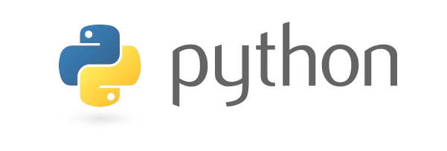

Introduction to Python
A readable, dynamic, pleasant, flexible, fast and powerful language

Slide 2
Overview
Background
Syntax
Types / Operators / Control Flow
Functions
Classes
Tools

Slide 3
What is Python
Multi-purpose (Web, GUI, Scripting, etc.)
Object Oriented
Interpreted
Strongly typed and Dynamically typed
Focus on readability and productivity

Slide 4
Features
Batteries Included
Everything is an Object
Interactive Shell
Strong Introspection
Cross Platform
CPython, Jython, IronPython, PyPy

Slide 5
Who Uses Python
Google
PBS
NASA
Library of Congress
the ONION
...the list goes on...

Slide 6
Releases
Created in 1989 by Guido Van Rossum
Python 1.0 released in 1994
Python 2.0 released in 2000
Python 3.0 released in 2008
Python 3.6.2 is the recommended version

Slide 7
Syntax

Slide 8
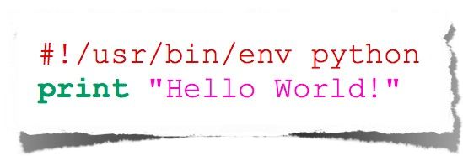
Hello World
hello_world.py

Slide 9
Indentation
Most languages don’t care about indentation
Most humans do
We tend to group similar things together

Slide 10
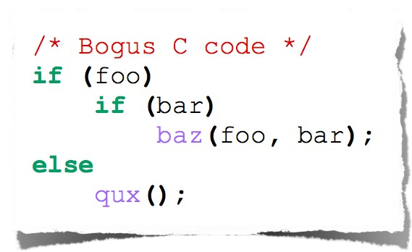
Indentation
The else here actually belongs to the 2nd if statement

Slide 11
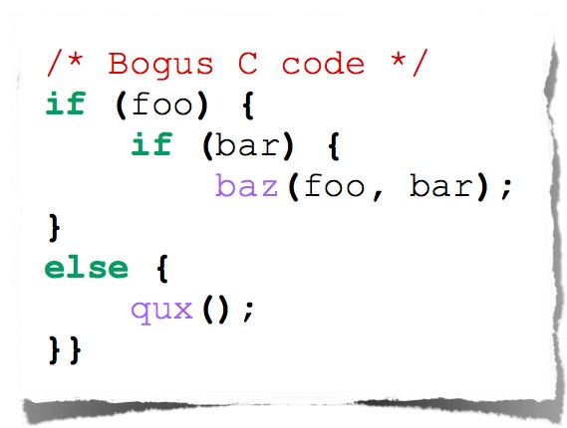
Indentation
The else here actually belongs to the 2nd if statement

Slide 12
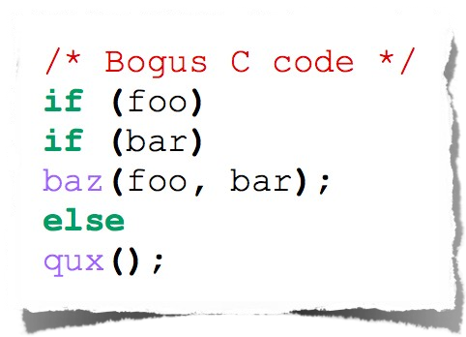
Indentation
I knew a coder like this

Slide 13
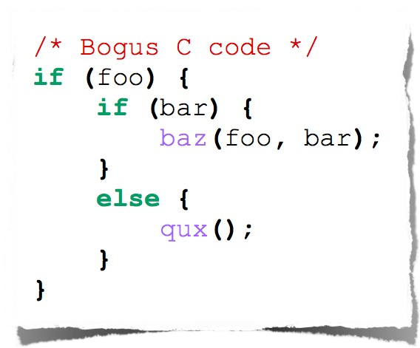
Indentation
You should always be explicit

Slide 14
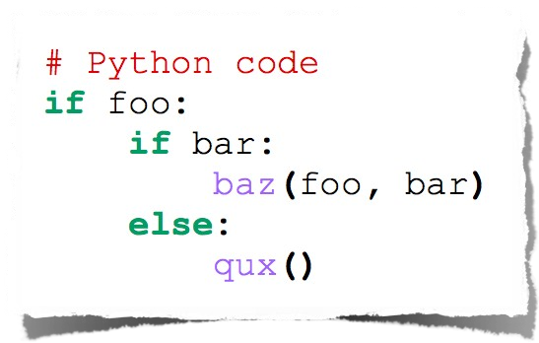
Indentation
Python embraces indentation
Text

Slide 15
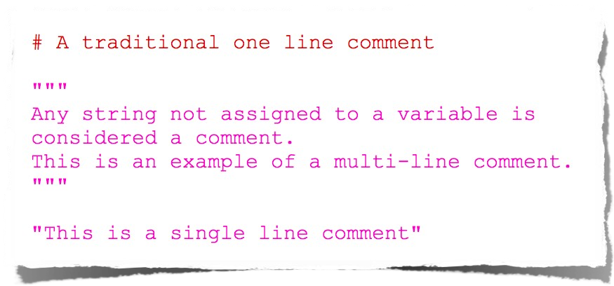
Comments

Slide 16
Types

Slide 17
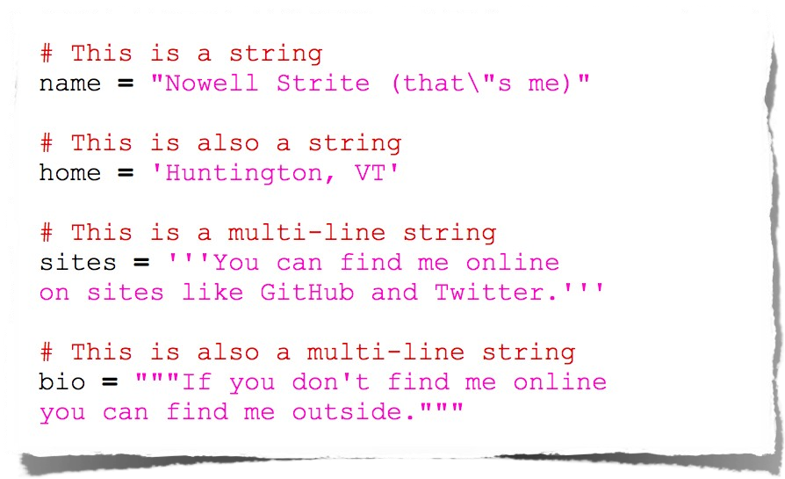
Strings

Slide 18
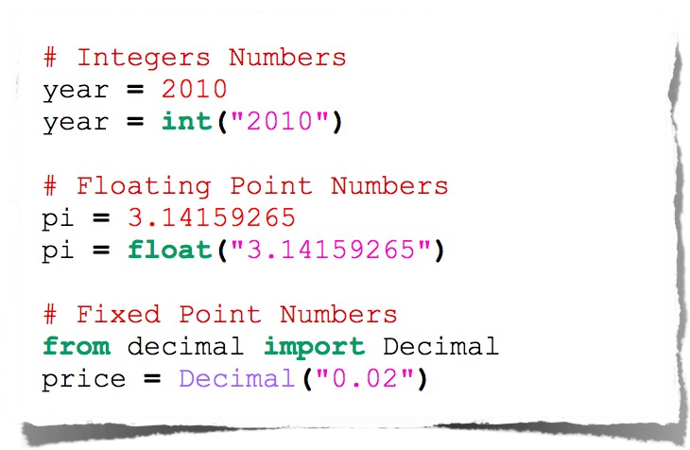
Numbers

Slide 19
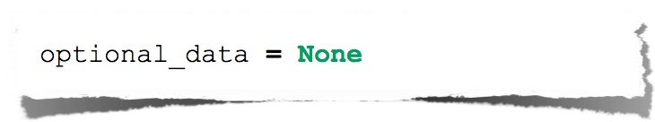
Null

Slide 20
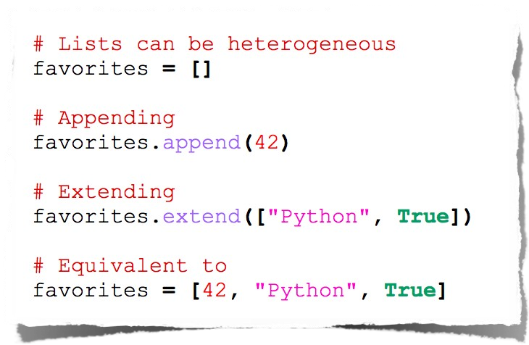
Lists

Slide 21
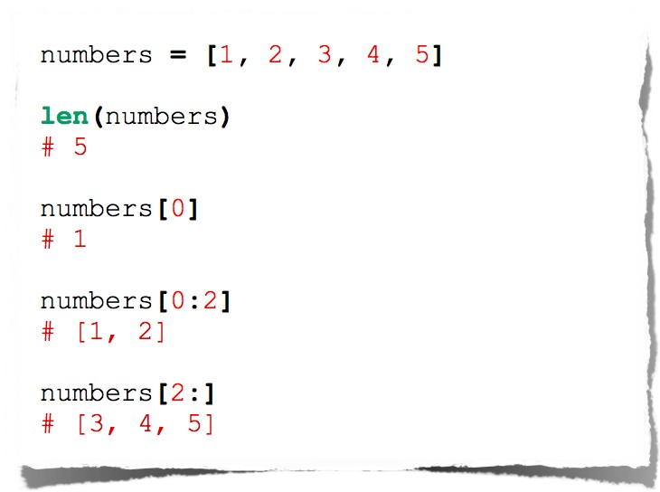
Lists

Slide 22
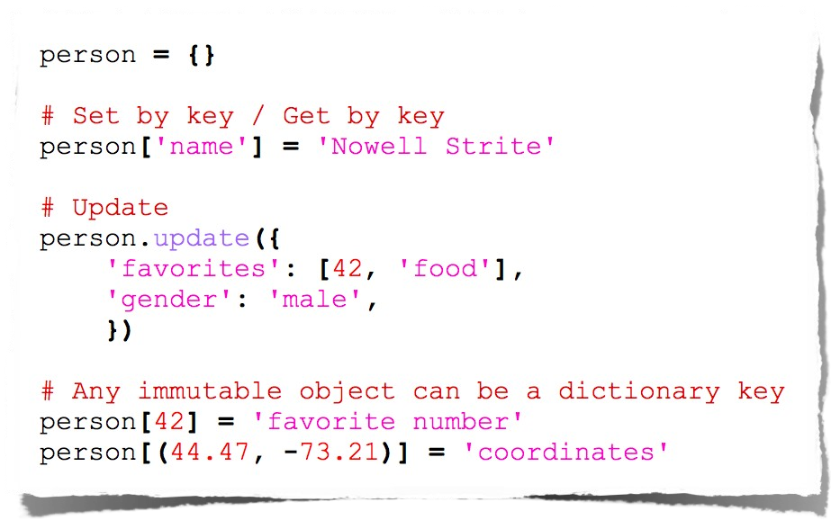
Dictionaries

Slide 23
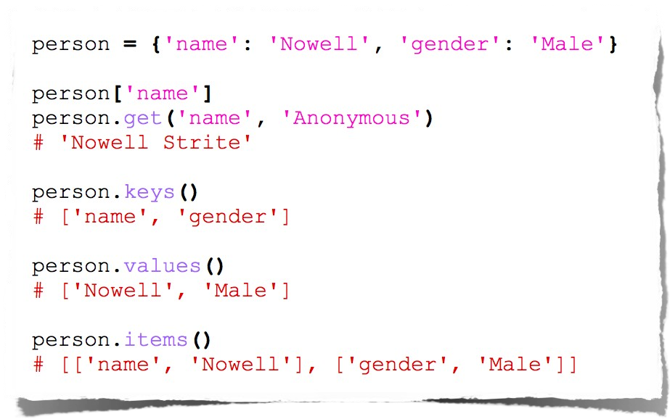
Dictionary Methods

Slide 24
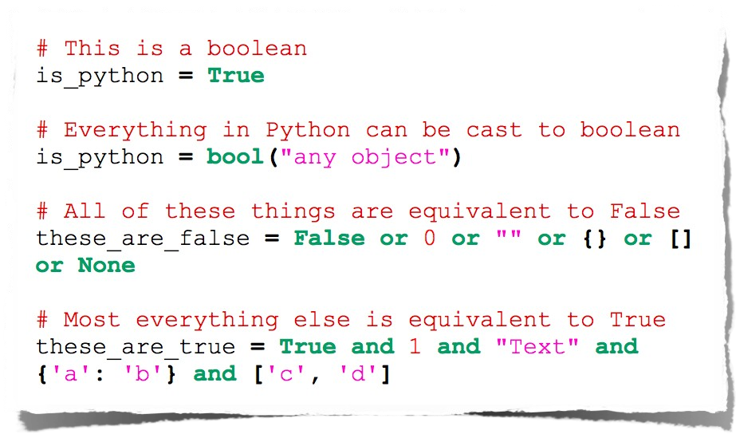
Booleans

Slide 25
Operators

Slide 26
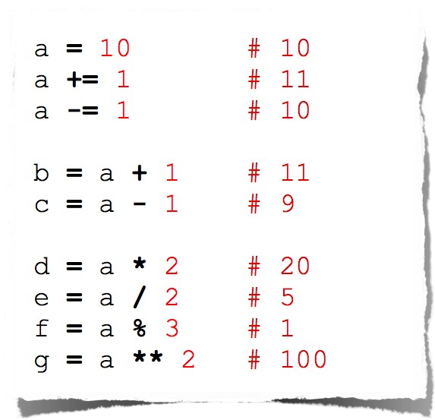
Arithmetic

Slide 27
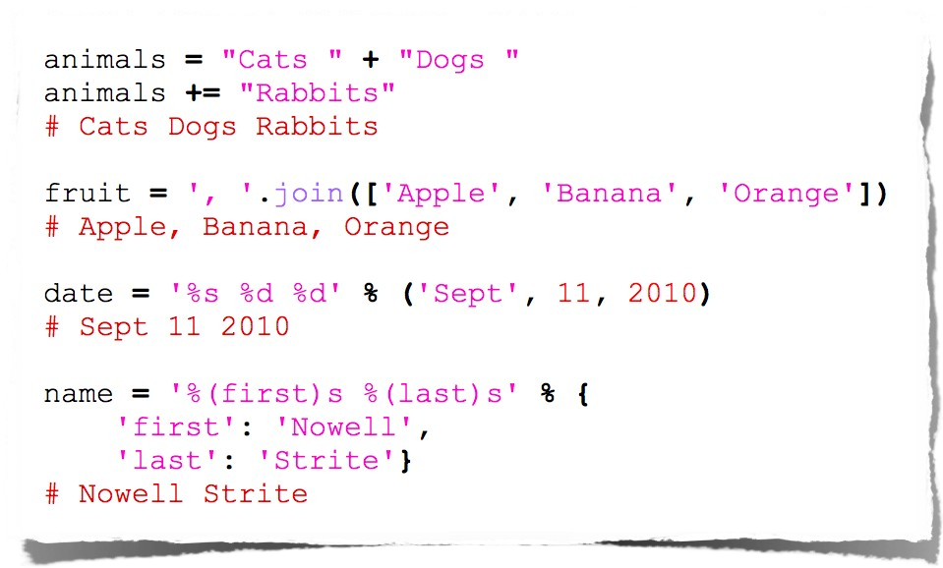
String Manipulation

Slide 28
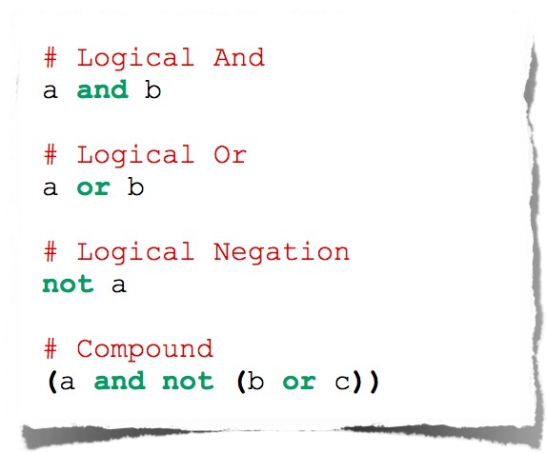
Logical Comparison

Slide 29
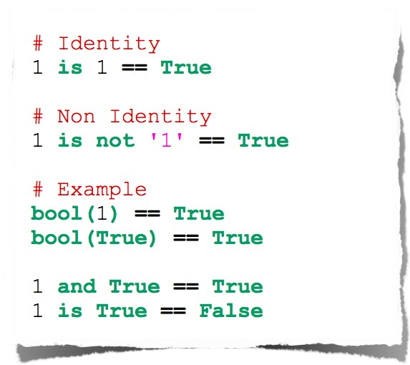
Identity Comparison

Slide 30
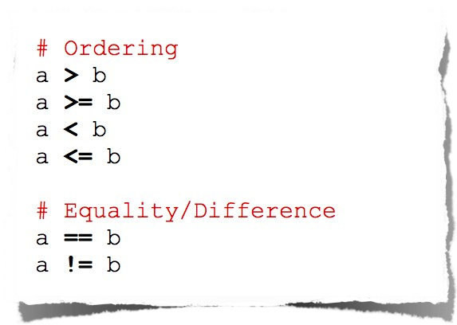
Arithmetic Comparison

Slide 31
Control Flow

Slide 32
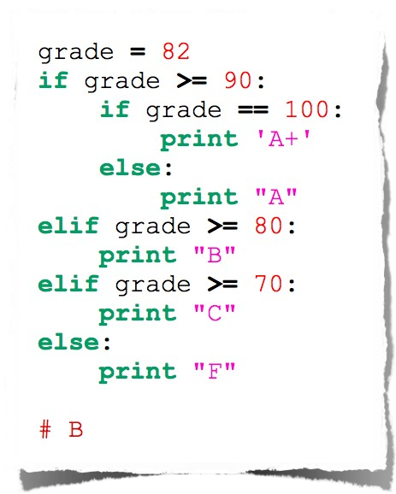
Conditionals

Slide 33
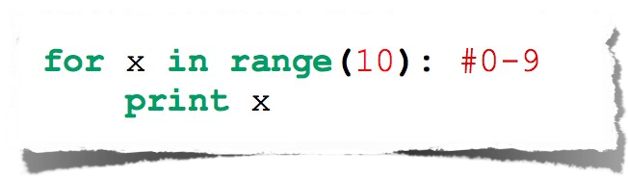
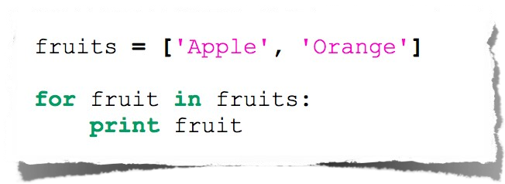
For Loop

Slide 34
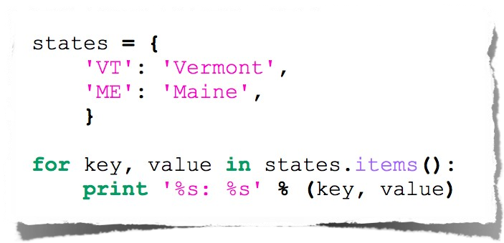
Expanded For Loop

Slide 35
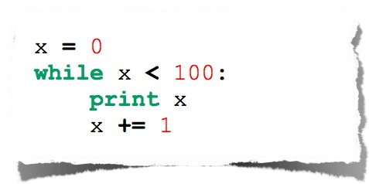
While Loop

Slide 36
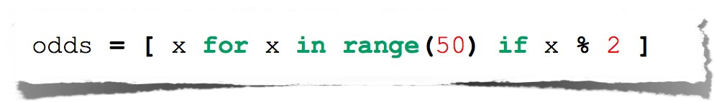
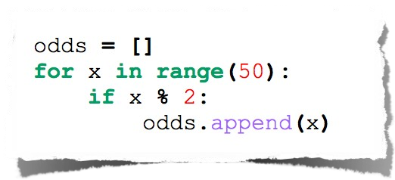
List Comprehensions
Useful for replacing simple for-loops.

Slide 37
Functions

Slide 38
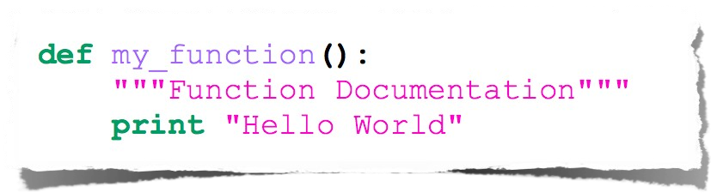
Basic Function

Slide 39
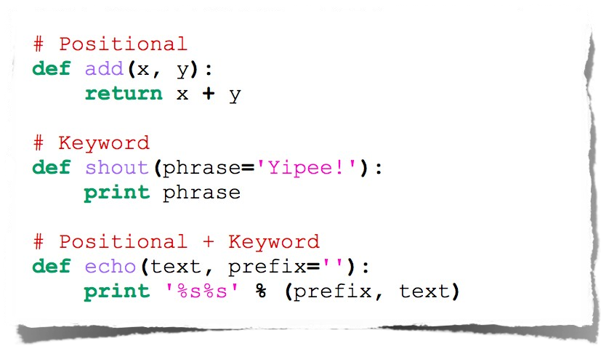
Function Arguments

Slide 40
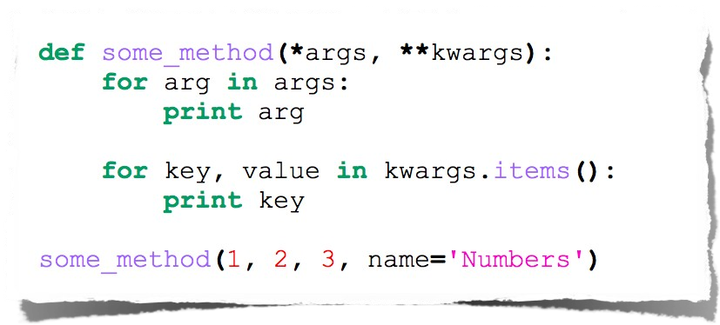
Arbitrary Arguments

Slide 41
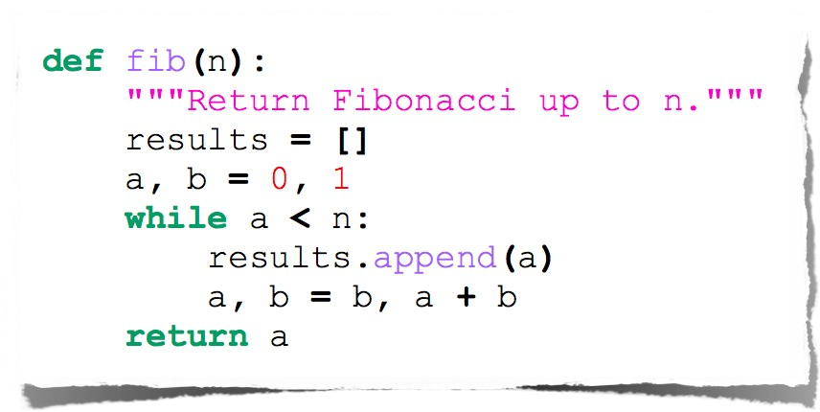
Fibonacci

Slide 42
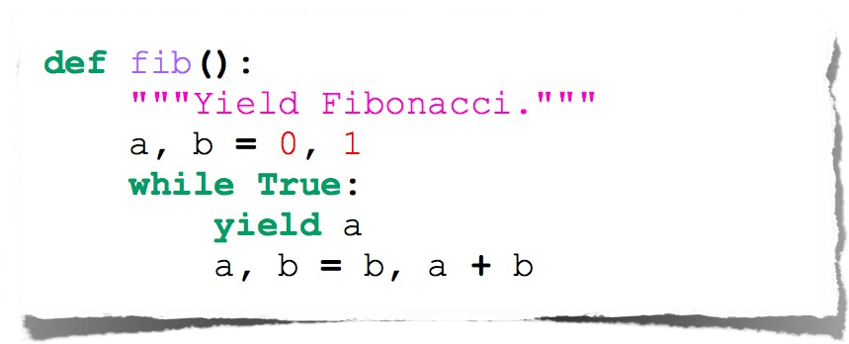
Fibonacci Generator

Slide 43
Classes

Slide 44
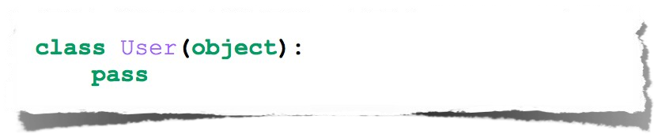
Class Declaration

Slide 45
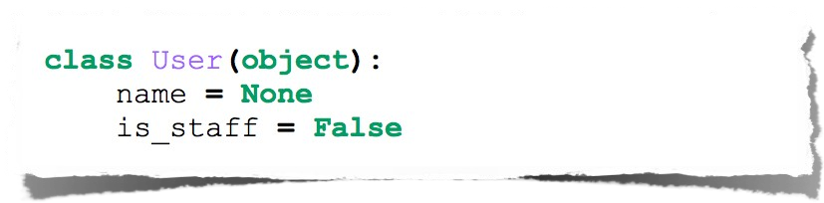
Class Attributes
Attributes assigned at class declaration should always be immutable

Slide 46
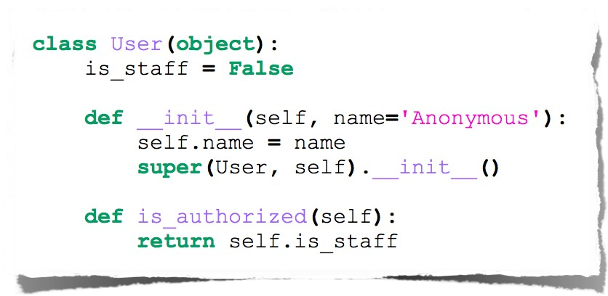
Class Methods

Slide 47
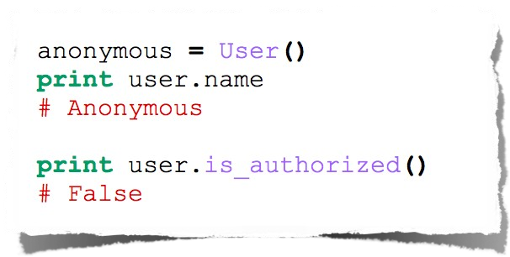
Class Instantiation & Attribute Access

Slide 48
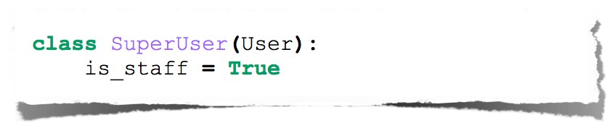
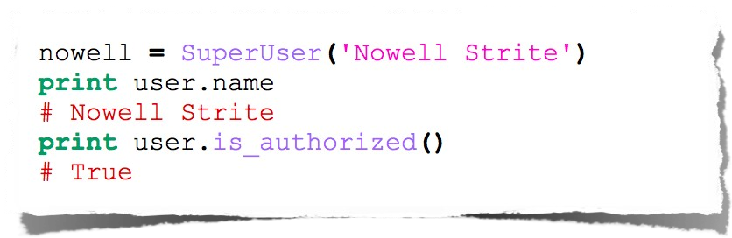
Class Inheritance

Slide 49
Python’s Way
No interfaces
No real private attributes/functions
Private attributes start (but do not end) with double underscores.
Special class methods start and end with double underscores.
•
init , doc , cmp , str

Slide 50
Imports
Allows code isolation and re-use
Adds references to variables/classes/functions/etc. into current namespace

Slide 51
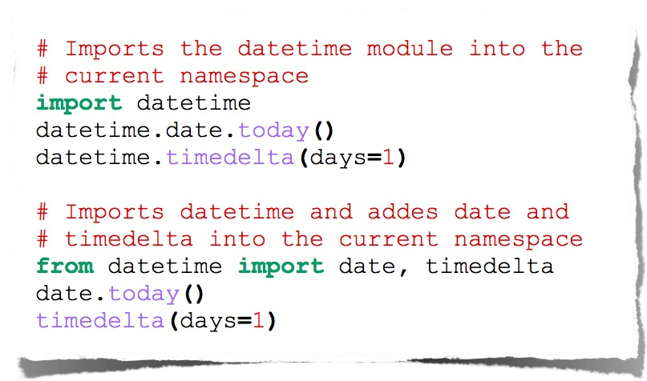
Imports

Slide 52
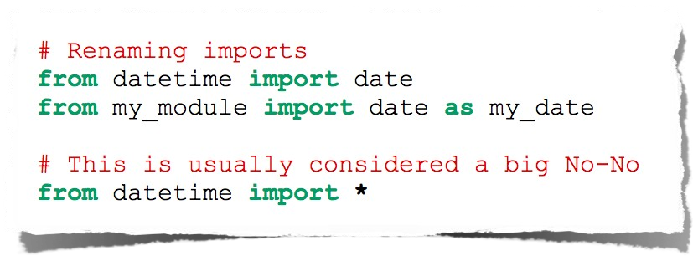
More Imports

Slide 53
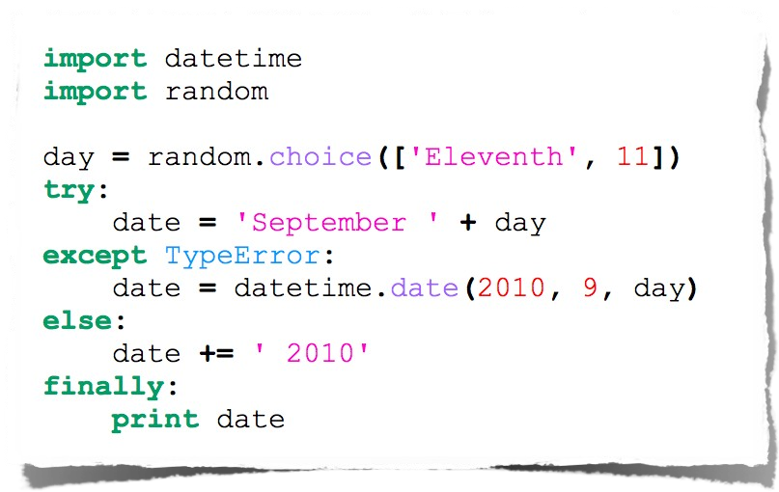
Error Handling

Slide 54
Documentation

Slide 55
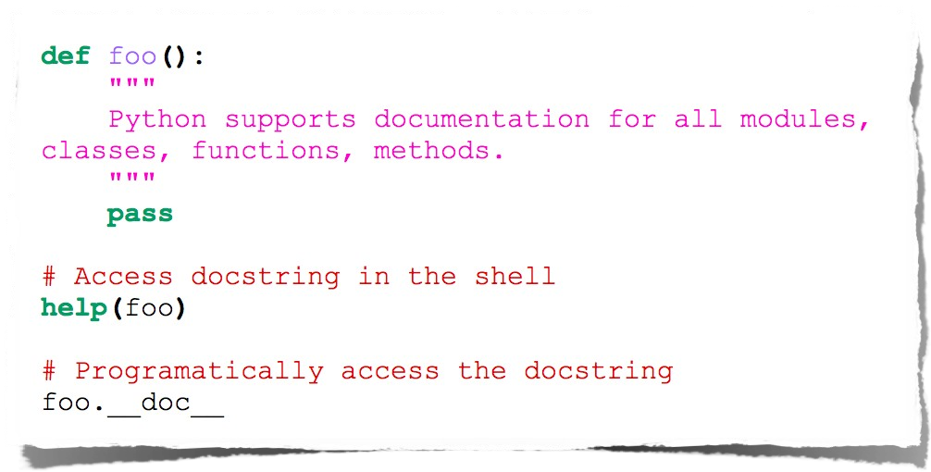
Docstrings

Slide 56
Tools

Slide 57
Web Frameworks
Django
Flask
Pylons
TurboGears
Zope
Grok

Slide 58
IDEs
Emacs
Vim
Komodo
PyCharm
Eclipse (PyDev)

Slide 59
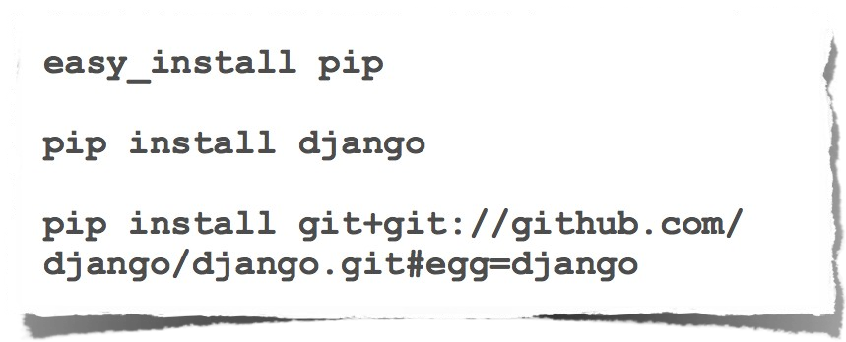
Package Management

Slide 60
Resources
http://python.org/
http://diveintopython.org/
http://djangoproject.com/

Slide 61
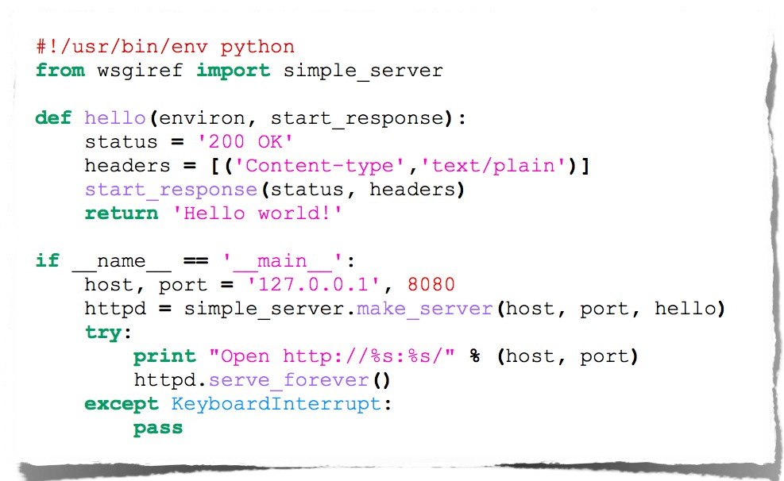
Example

Slide 62
Going Further
Decorators
Context Managers
Lambda functions
Generators
...

Slide 63
Questions?

